Slide 1

NBA Points Prediction Dashboard
An End-to-End Data Science Pipeline to Predict NBA Player Performance
Presented by : Kushal Senapathi

Slide 2
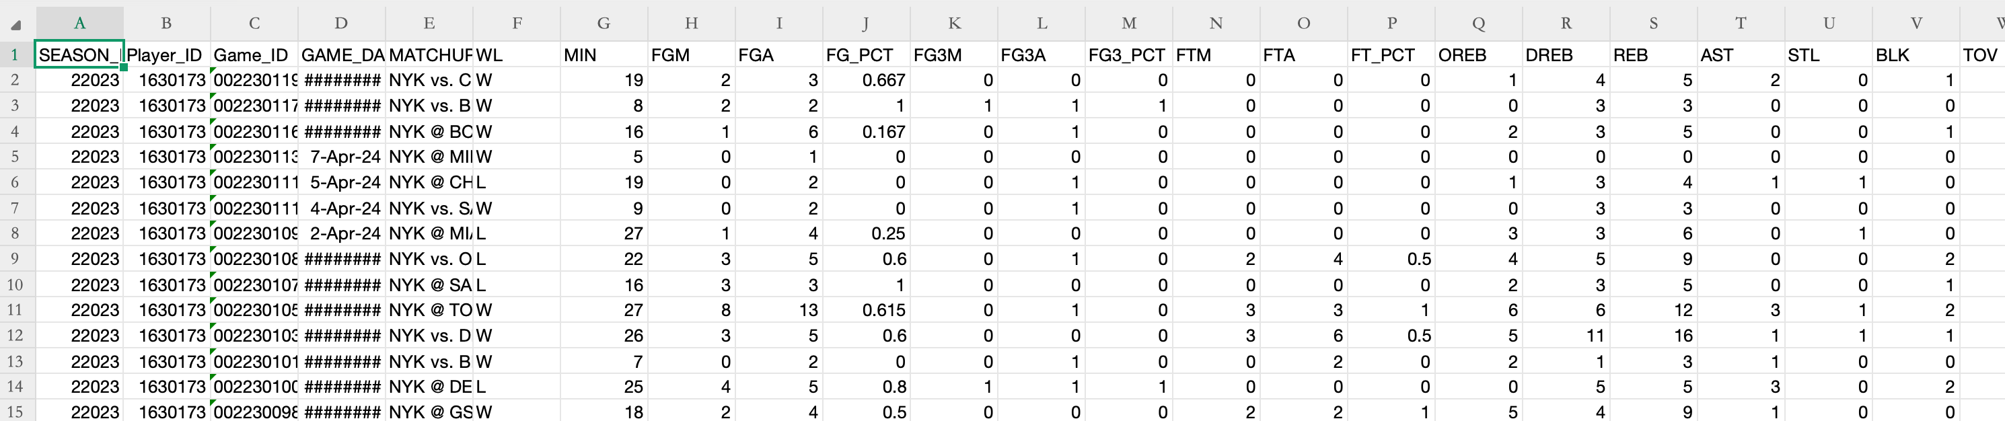
The Goal & The Data
Goal: Can we build a model that accurately predicts a player’s points?
Data: 2023–24 NBA season — 23,000+ game logs.
Focus: Identify which features are most predictive.

Slide 3
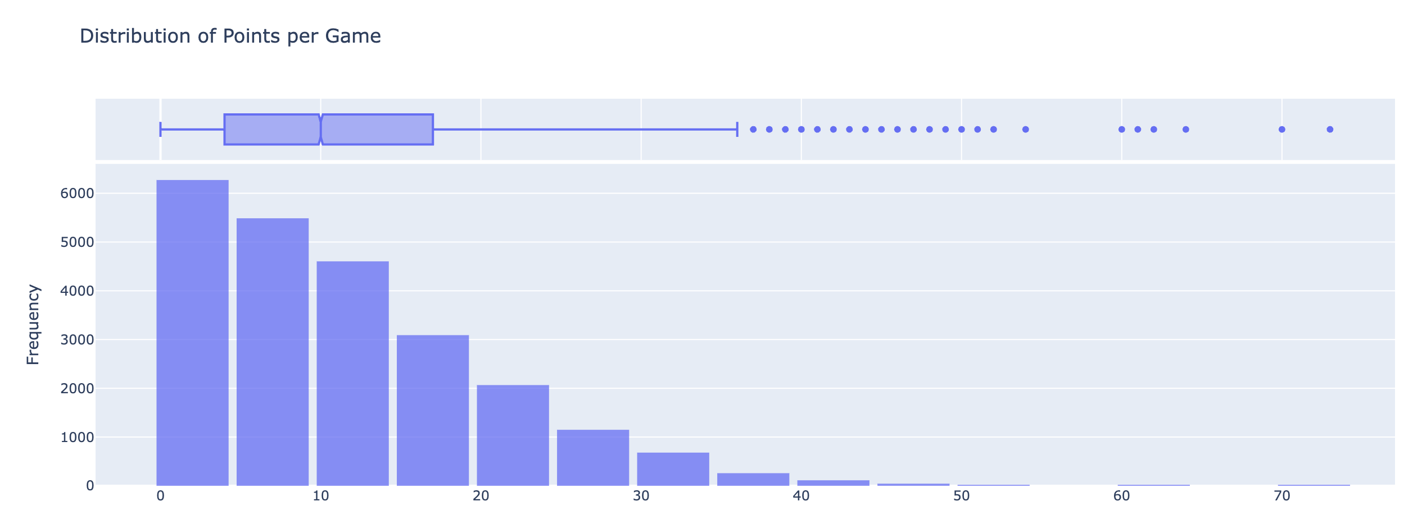
Exploratory Data Analysis (EDA)

Slide 4
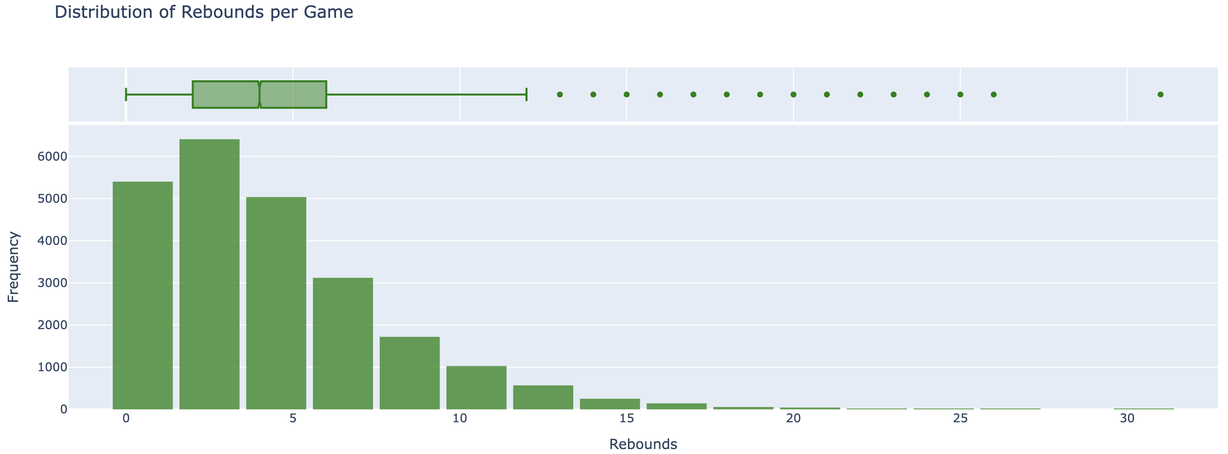
EDA

Slide 5
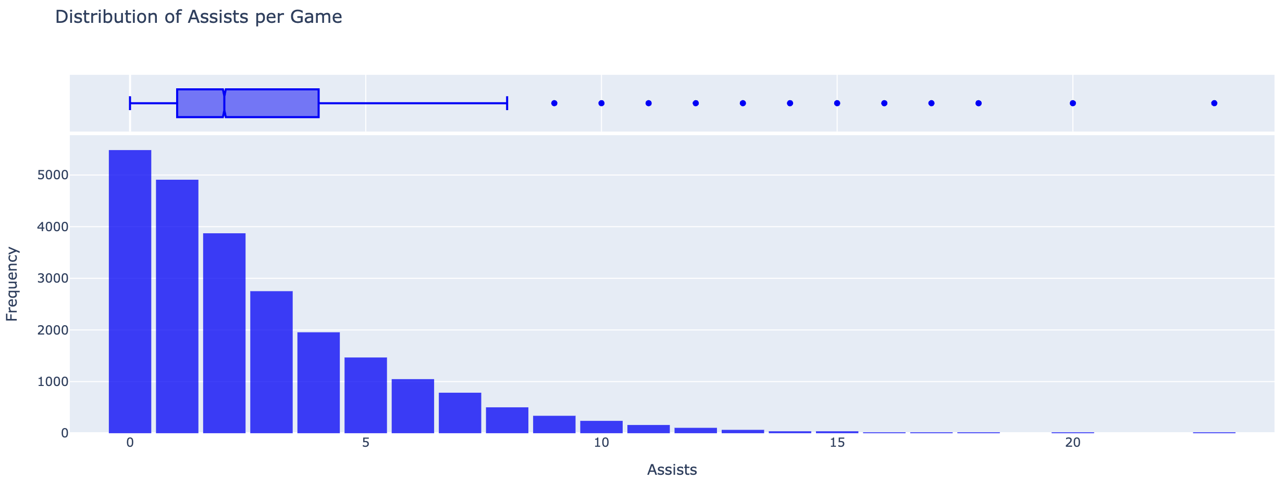
EDA

Slide 6
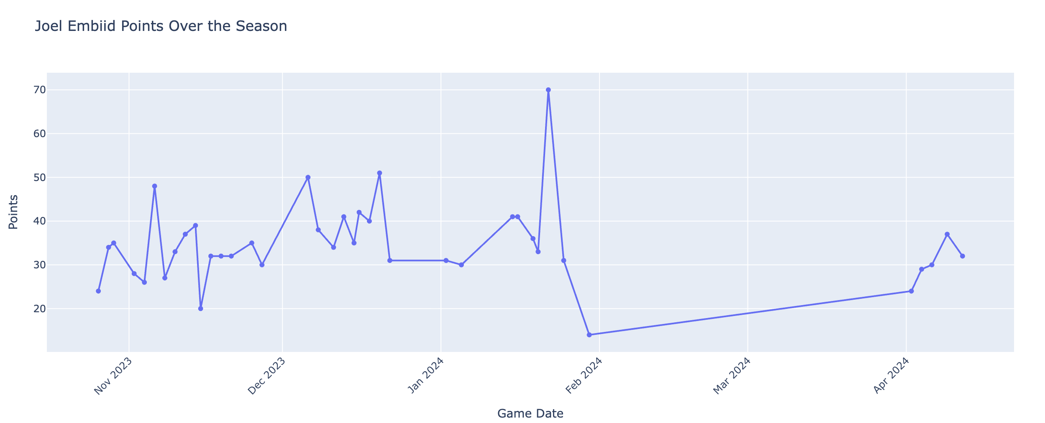

Slide 7
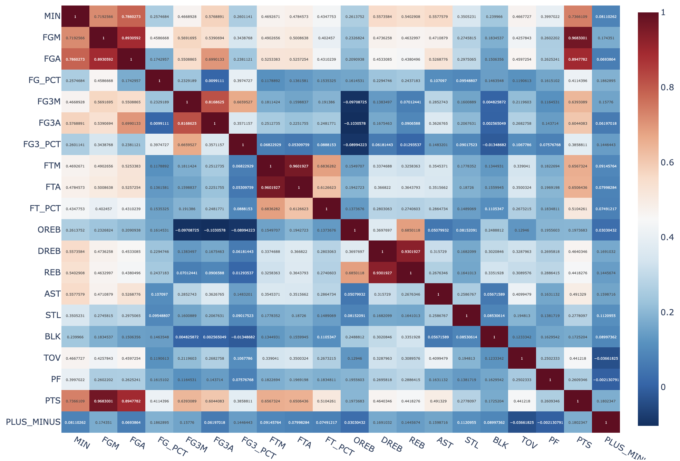
Correlation Heatmap :

Slide 8
Findings from EDA
FGM (Field Goals Made): A correlation of 0.97, as made shots are the direct source of points.
FGA (Field Goals Attempted): A correlation of 0.89, proving that shot volume is a powerful predictor of scoring output.
MIN (Minutes Played): A correlation of 0.74, indicating that more time on the court leads to more scoring opportunities.
Minutes → Shots → Points

Slide 9
Feature Engineering
🏠 1. Context Features
HOME – 1 if home game (vs.), else 0
Days_Rest – Days since last game (captures fatigue & recovery)

Slide 10
Feature Engineering
2. Player-Level Rolling Features (5-game window, shifted by 1 to avoid leakage)
PTS_roll_5 – Avg points in last 5 games
PTS_std_5 – Std deviation of points
MIN_roll_5 – Avg minutes played
MIN_std_5 – Std deviation of minutes
FGA_roll_5 – Avg field goal attempts
FTA_roll_5 – Avg free throw attempts
AST_roll_5 – Avg assists
REB_roll_5 – Avg rebounds
FG3A_roll_5 – Avg 3-point attempts
TOV_roll_5 – Avg turnovers
USG_proxy_roll_5 – Avg usage proxy (FGA + FTA + TOV)
PACE_proxy_roll_5 – Avg pace proxy (FGA + AST + TOV)

Slide 11
Feature Engineering
Team-Level Rolling Features (5-game averages)
TEAM_PTS_roll_5 – Team’s avg total points scored
OPP_DEF_STR_roll_5 – Opponent’s avg points allowed
OPP_PACE_roll_5 – Opponent’s avg tempo (pace proxy)

Slide 12
Feature Engineering
Raw Game Logs
↓
Player Rolling Features
↓
Team Strength Features
↓
Final Feature Table for Modeling

Slide 13
Model Preparation
Define Features and Target
Features (X) → 17 engineered variables capturing:
Player performance trends
Team & opponent context
Game conditions (home/away, rest days)
Target (y) → Player’s Points (PTS) in the upcoming game

Slide 14
Model Preparation:
Handle Missing Values
Dropped rows where rolling averages (e.g., PTS_roll_5) were NaN → These occur for first few games of each player
Ensures model trains only on complete and reliable data

Slide 15
Model Preparation
Chronological Train–Test Split
Cutoff Date: March 1, 2024
Training Set: Games before March 1 (used to fit model)
Test Set: Games on or after March 1 (used for evaluation)
This approach prevents data leakage and simulates real-world forecasting (predicting unseen future games)

Slide 16
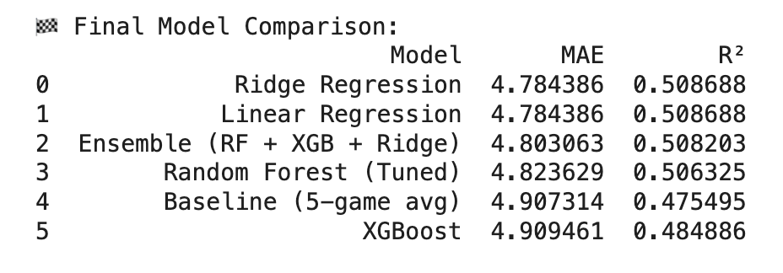
Model Training & Evaluation (“The Contest”)
Models Tested:
Baseline (5-game average)
Linear Regression
Ridge Regression
Random Forest (Tuned)
XGBoost
Ensemble (RF + XGB + Ridge)
Best Model: Ridge Regression

Slide 17
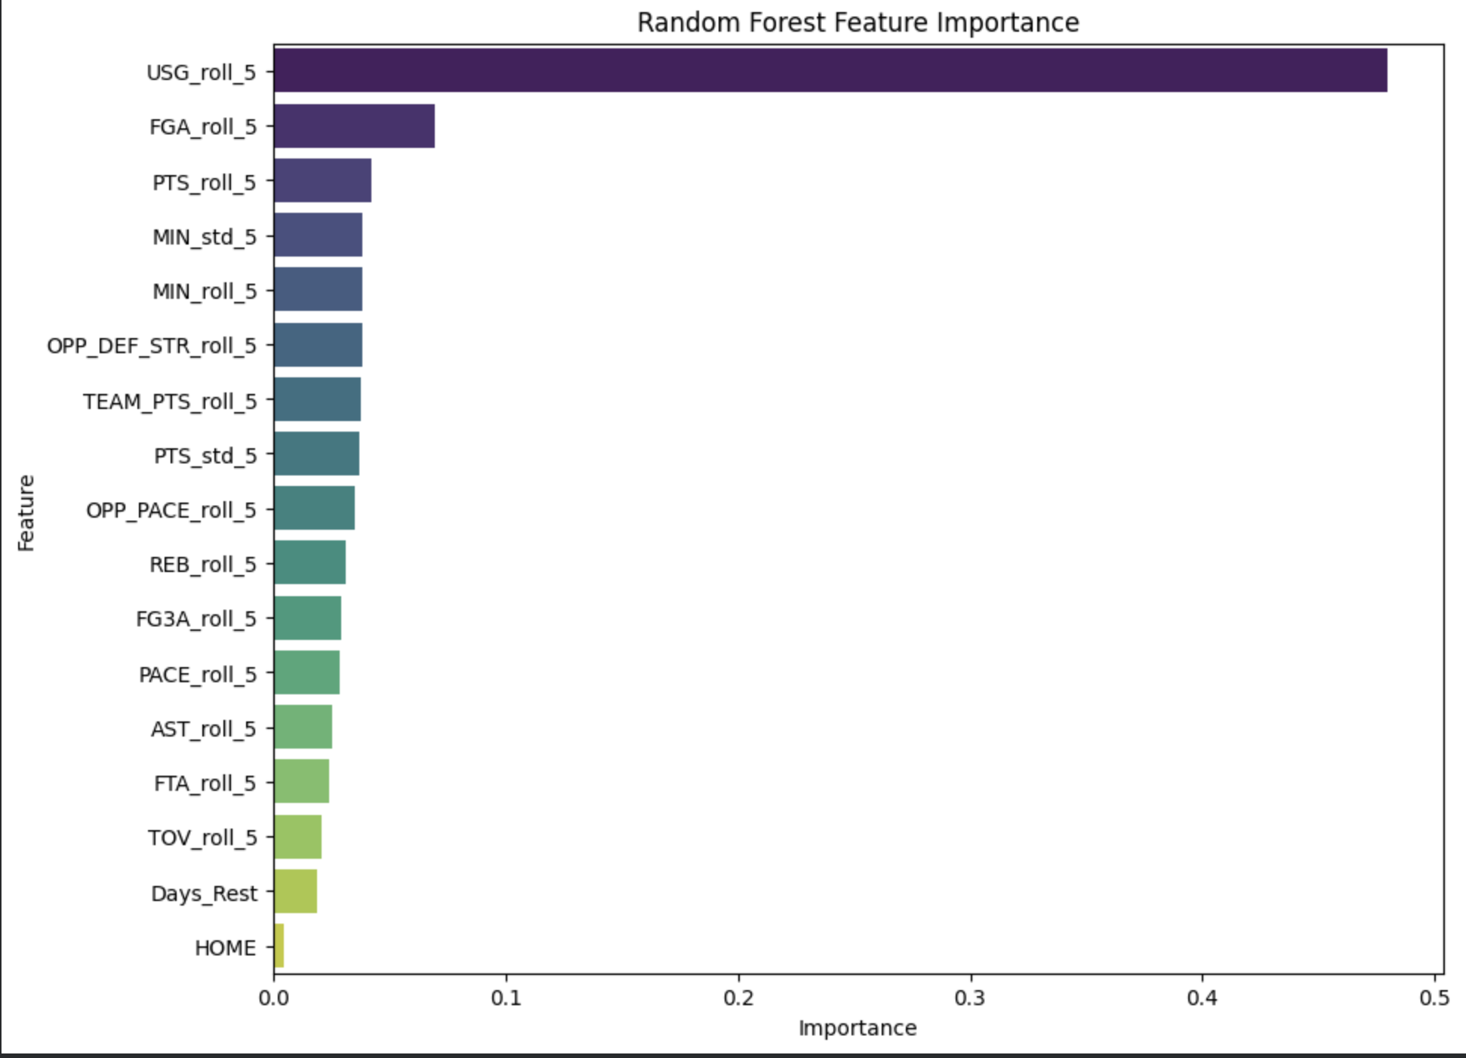
Results

Slide 18
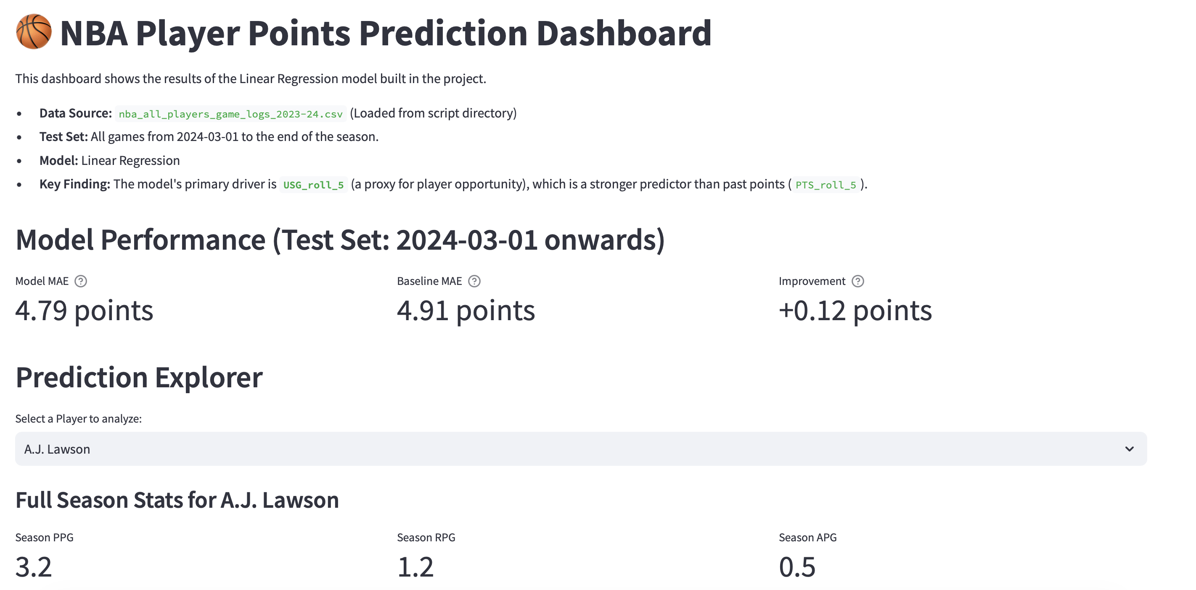
The Final Product (“The NBA Dashboard”)
Built using Streamlit

Slide 19
THANK YOU

